Slide 1
AMIA 2016 -- System Demonstration S55
Beyond SMART Remote Decision Support with CDS Hooks
David McCallie, MD, FACMI (Cerner)
Josh Mandel, MD (Verily)
Kevin Shekleton (Cerner)
Howard Strasberg, MD, FACMI (Wolters Kluwer Health)
Scott Narus, PhD (Intermountain Healthcare)
Peregrin Marshall (RxREVU)
Peter DeVault (Epic)
Isaac Vetter (Epic)
November 14, 2016

Slide 2
Disclosures of Conflict of Interest
The presenters who work for a vendor will have the vendor listed beside their name on the title slide.
Each presenter will state any other conflict of interest disclosures before their part of the presentation.

Slide 3
Agenda
Setting the Context
FHIR, SMART, and market forces around standard-based APIs
CDS Hooks
Project overview and technical details
CDS Hooks Demo
Prototype work from EHR vendors and CDS service providers
What’s Next
Future challenges and Q&A

Slide 4






What’s driving demand for Open Platforms?
JASON report → APIs → MU 3 APIs
Increasing demand for more sophisticated interoperability in era of “value-based care”
Provider consolidation leaves orgs with need to integrate disparate systems
Providers expect more from EHRs
Expectations based on consumer experience with smart phones, etc.
Open is better for healthcare!
Government & Market Pressures
MU3 - APIs
Value-Based Care
Industry Consolidation
User
Expectations
Notes:
Meaningful Use 3 will require use of APIs to improve patient engagement.
MU3 requirement based on View Download, Transmit Criteria full document on Health IT.gov
Medicare reimbursement determined by care quality, cost and clinical practice improvement.
Medicare reimbursement fact pulled from CMS.gov – Centers for Medicare & Medicaid Services. Medicare Access and CHIP Reauthorization Act of 2015 (MACRA)
Record-breaking number of acquisitions/joint ventures leave create more pressure on orgs to integrate across disparate systems.
2015 was a record-breaking year for affiliations, joint ventures, partnerships, mergers and acquisitions – PricewaterhouseCoopers
A Peer60 report on Healthcare C-Suite indicates mergers and acquisition are the top concern of CIOs, who are left to mastermind how to integrate disparate solutions and systems following consolidation.
Providers want open platforms and standards-based APIs to replace costly, slow interface development, to support substitutability, and liberate data to allow liquidity between disparate systems.
Our clients are all consumers of technology built on open platforms and they have expectations that their EHR experience should offer the same level of usability and cross application data availability as they are used with their devices at home.
KLAS Sept. 2015 Report on Interoperability indicates providers hope for advancing interoperability rests in Standards-based APIs like SMART on FHIR
Open platforms was a key topic at eHealth Initiative Annual Conference in Washington DC in February – these demands were taken from CIO quotes at the conference.

Slide 5






Will EHRs become “platforms?”
Platforms have transformed other industries
EHR-as-Platform? EHR responsible for:
User and patient management
Core workflows (orders, etc.)
Legal medical record (data persistence)
Regulatory functions
Platform extensions to:
Address functional gaps
Increase choice
Encourage innovations
“Substitutable Medical Applications and Reusable Technology”
“Fast Health Interoperability Resources”

Slide 6
Emerging Standards to enable Open Platforms
FHIR = “Fast Health Interoperability Resources”
A standard for accessing health care data (“Resources”)
ReSTful API design leverages Internet standards (HTTP, etc.)
Created by Health Level 7 International (HL7)
Emerging support by most major HIT providers (e.g., Argonaut Project)
Meets EHR Certification for MU3
SMART = “Substitutable Medical Applications and Reusable Technology”
A SMART App is typically a Web App
HTML5 + JavaScript
Embedded in EHR
EHR Data Access is via FHIR
OAuth 2 for security and context passing
Also supports smart-phone and patient-controlled apps

Slide 7
FHIR: Data APIs as interop “building blocks”
AdverseReaction
Alert
AllergyIntolerance
CarePlan
Composition
ConceptMap
Condition
Conformance
Device
DeviceObservationReport
DiagnosticOrder
DiagnosticReport
DocumentReference
DocumentManifest
Encounter
FamilyHistory
Group
ImagingStudy
Immunization
ImmunizationRecommendation
List
Location
Media
MedicationOrder
MedicationAdministration
MedicationDispense
MedicationPrescription
MedicationStatement
MessageHeader
Observation
OperationOutcome
Order
OrderResponse
Organization
Other
Patient
Practitioner
Procedure
Profile
Provenance
Query
Questionnaire
RelatedPerson
SecurityEvent
Specimen
Substance
Supply
ValueSet

Slide 8

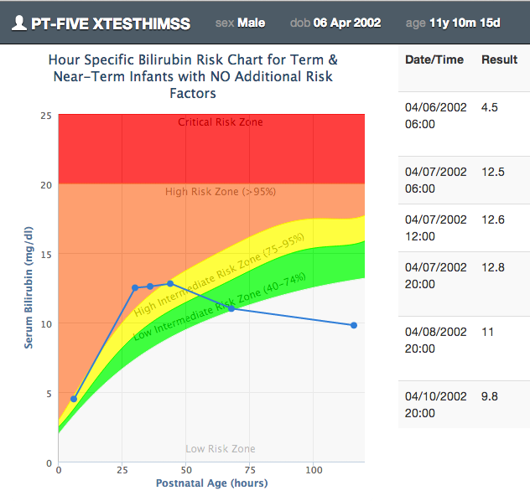

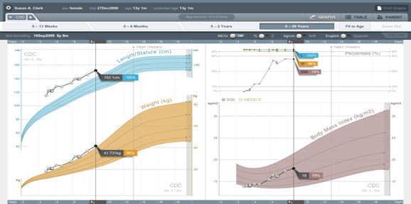





Multi-vendor SMART/FHIR demos at HIMSS ’14, ‘15, ‘16
Mobile Apps
Web Apps
OAuth 2.0
FHIR Data Profiles
Supporting Health IT Systems
HSPC
Healthcare Services Platform Consortium

Slide 9
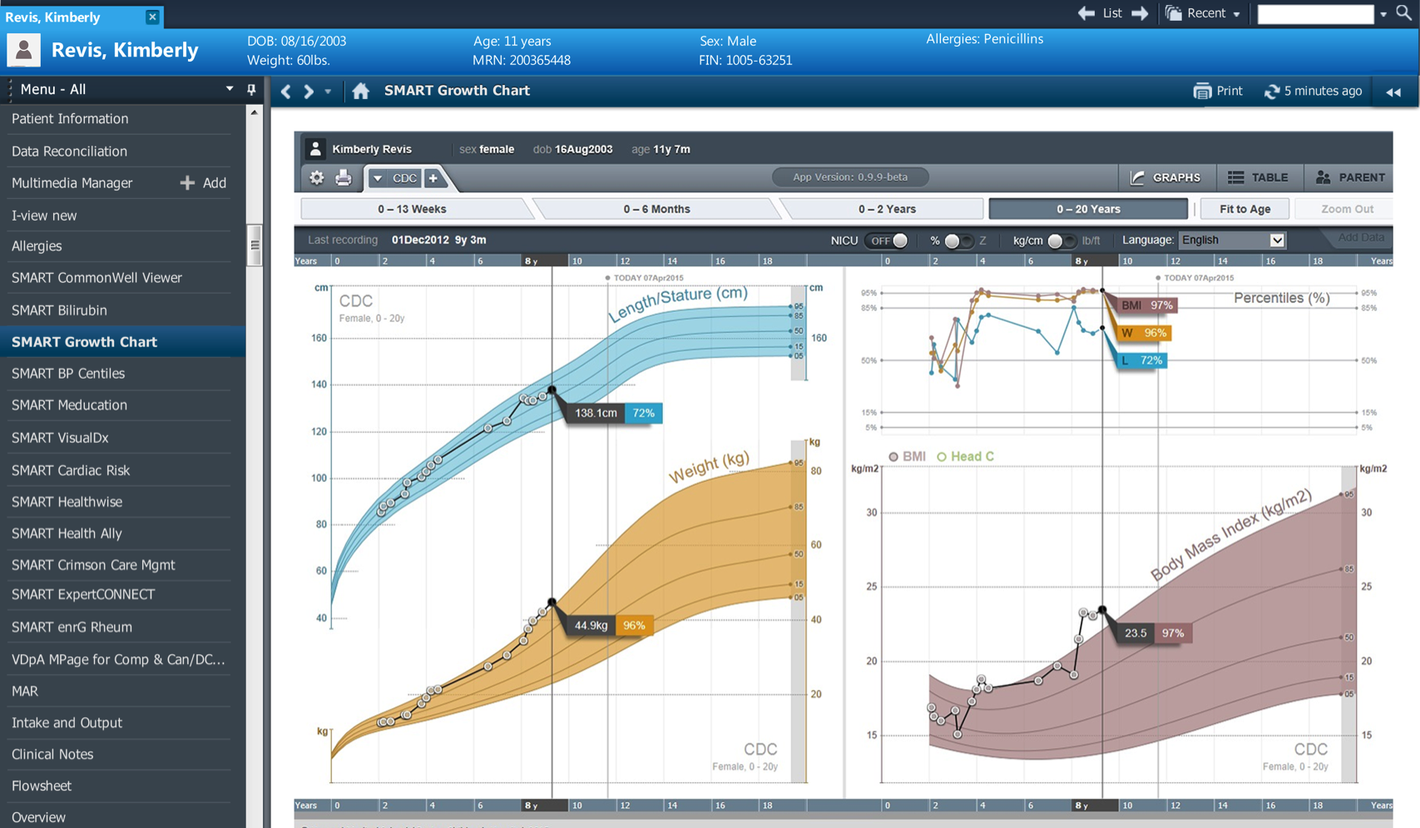
SMART apps - Pediatric growth chart
Developed at Boston Children’s Hospital
Shows more information than the “built-in” growth chart
Adjusts for special conditions like Down’s Syndrome

Slide 10
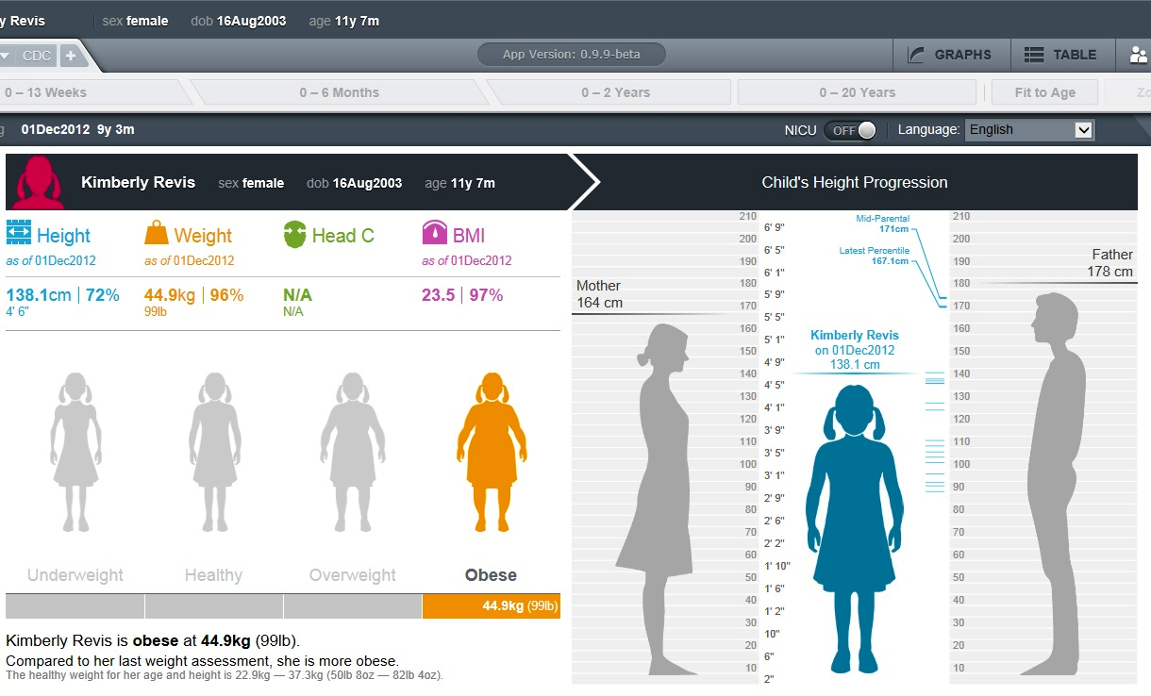
Pediatric growth chart – innovative parent’s view
Custom view optimized for communication with parents and child
Visually project height in terms of parent’s height
Print copy for parents, or email via portal

Slide 11
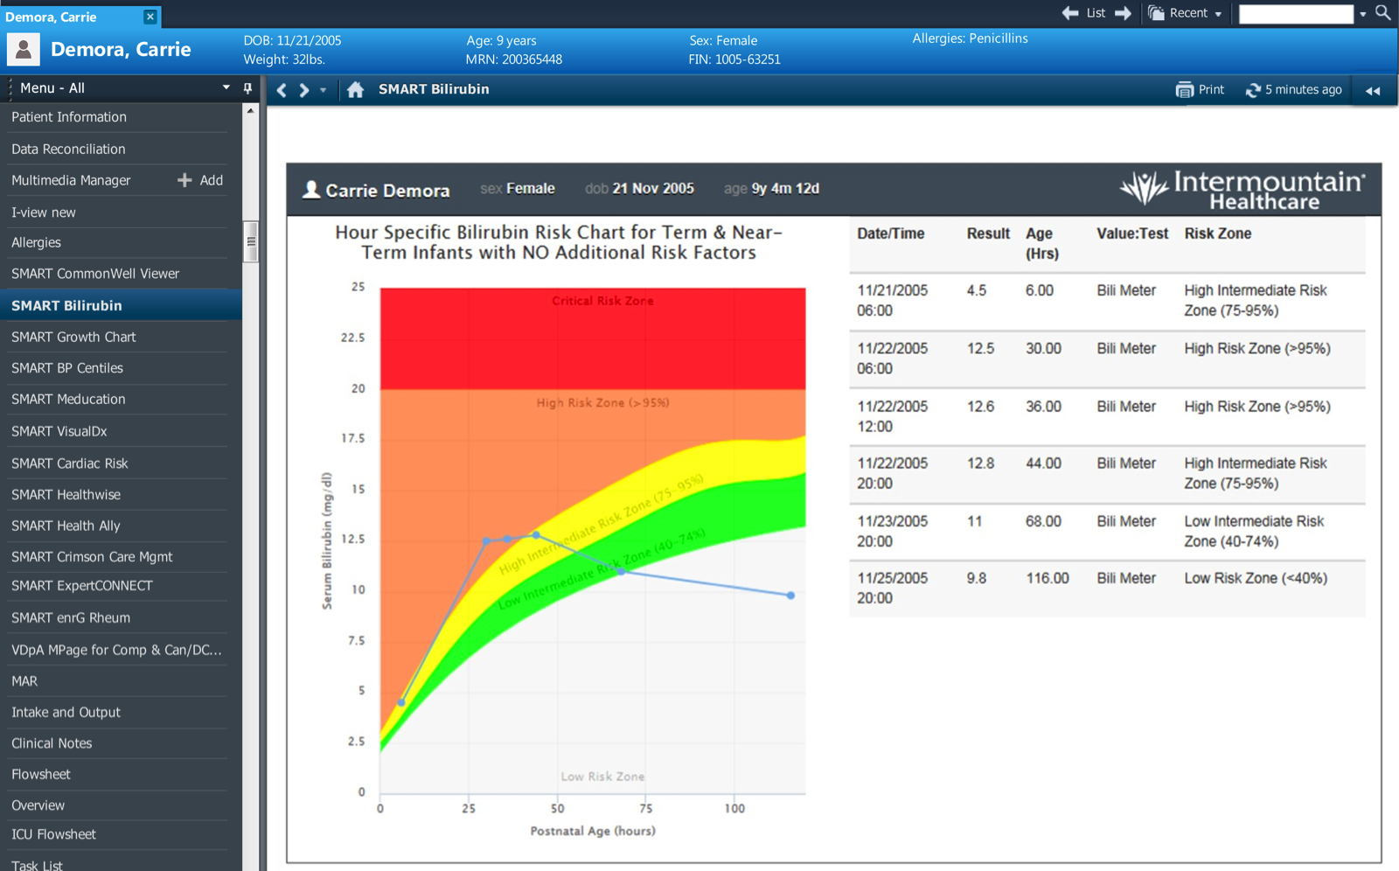
SMART App - Neonatal bilirubin
Developed at Intermountain
Guides duration of phototherapy to prevent neonatal brain damage
Relevant to a limited set of patients, and for a limited time
Requires a menu click to be invoked

Slide 12
The problem with “apps” for CDS?
User has to know that the app exists
User has to know that the app is relevant
User has to find the link and launch it

Slide 13


Slide 14


CDS Hooks A vendor agnostic decision support specification
Initiated by Josh Mandel, architect of SMART
Open source (Apache)
Emerging standard with active development and widespread participation from stakeholders
Notes:
Josh Mandel’s work “was supported in part through the SMART Advisory Committee and and a grant from the RxFoundation”

Slide 15
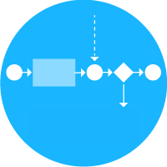

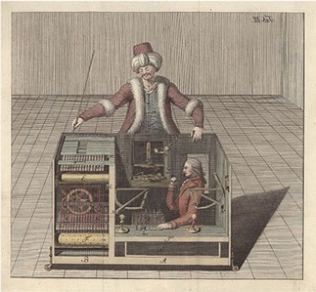

CDS Service
A service that is:
invoked by the EHR via a hook,
evaluates its own logic using FHIR data,
returns decision support via cards or decisions
Notes:
The important thing to call out here is that CDS Hooks doesn’t care how the CDS service is implemented.

Slide 16
Example Hooks
patient-view
When a patient’s chart is opened
medication-prescribe
When a medication is selected for prescription
order-review
Viewing pending orders for signing
Notes:
Hooks are the separation / cleavage point between the EHR and CDS providers. These are the current hooks the specification has defined but this is not an exhaustive or complete list of possible hooks.
(for discussion at the end of the presentation mention:
We expect there to be set of standard hooks but EHR vendors will likely define their own hooks outside of the standard based upon their respective capabilities)

Slide 17


EHR
CDS Service
POST https://example.com/cds-services/example-service
{
"hook": "patient-view”,
"fhirServer": "http://fhir.example.com",
"user": "Practitioner/789",
"patient": "123",
"encounter": "456",
...
}

Slide 18
EHR
CDS Service
CDS Service Logic
POST https://example.com/cds-services/example-service

Slide 19
EHR
CDS Service
POST https://example.com/cds-services/example-service
HTTP 1.1/ 200 OK
{
"cards": [
{
"summary": "Example card",
"indicator": "info",
"source": {
"name": "Demo CDS Service”
}}]}

Slide 20
Cards
A CDS Service can return any number of cards
The EHR renders each card as it sees fit
Each card must have:
A concise summary (140 characters)
An indicator noting the importance of the card
Information on the organization or data set that is the source of the card’s data

Slide 21
CDS Service Response JSON
{
"cards": [
{
"summary": "Example card",
"indicator": "info",
"source": {
"name": "Demo CDS Service”
}
}
]}
Notes:
Point out that this is an array of cards

Slide 22
Card Indicator
Success
Info
Warning
Hard Stop

Slide 23
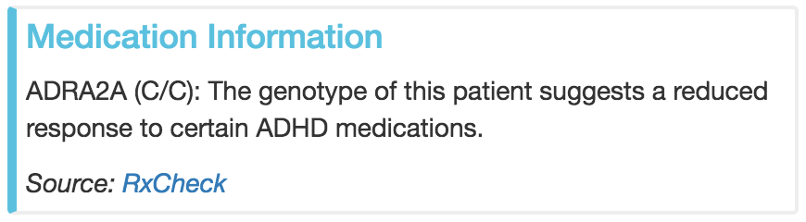

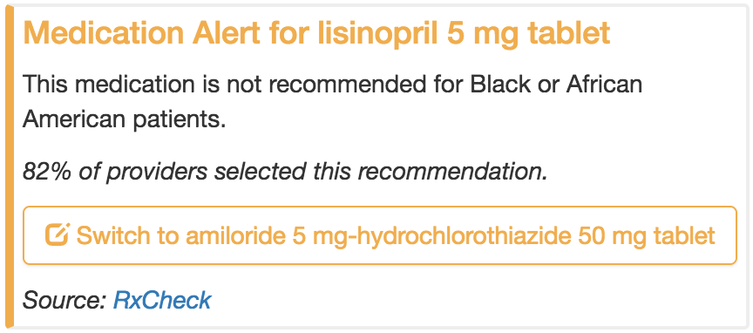


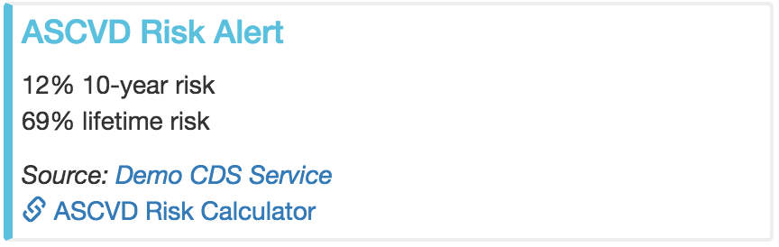
Common Card Examples
Information Only
Textual information for the provider
Suggestions
Proposed actions encoded as FHIR resources
App Links
Proposed SMART app that should be used

Slide 24
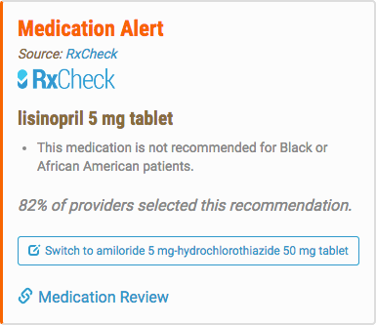
Cards can contain any combination of information, suggestions, and links

Slide 25
Capturing user behavior for analytics
Since CDS Services return purely JSON, they don’t know how users interact with their suggestion
Each suggestion may contain a UUID
The UUID allows the EHR to notify the CDS Service that the user interacted with their suggestion
POST {cds-service}/analytics/{uuid}
Notes:
Possibly skip over in the interest of time

Slide 26
Decisions
App links are intended to provide a feedback loop back to the EHR via decisions
After interacting with an app link, the app redirects back to the EHR which triggers the same hook invocation
The CDS Service now returns decisions instead of cards which the EHR uses to reflect appropriately

Slide 27

Decisions
App links are intended to provide a feedback loop back to the EHR via decisions
After interacting with an app link, the app redirects back to the EHR which triggers the same hook invocation
The CDS Service now returns decisions instead of cards which the EHR uses to reflect appropriately
Notes:
This is largely designed on paper right now but will need to be proved out with implementer feedback.

Slide 28
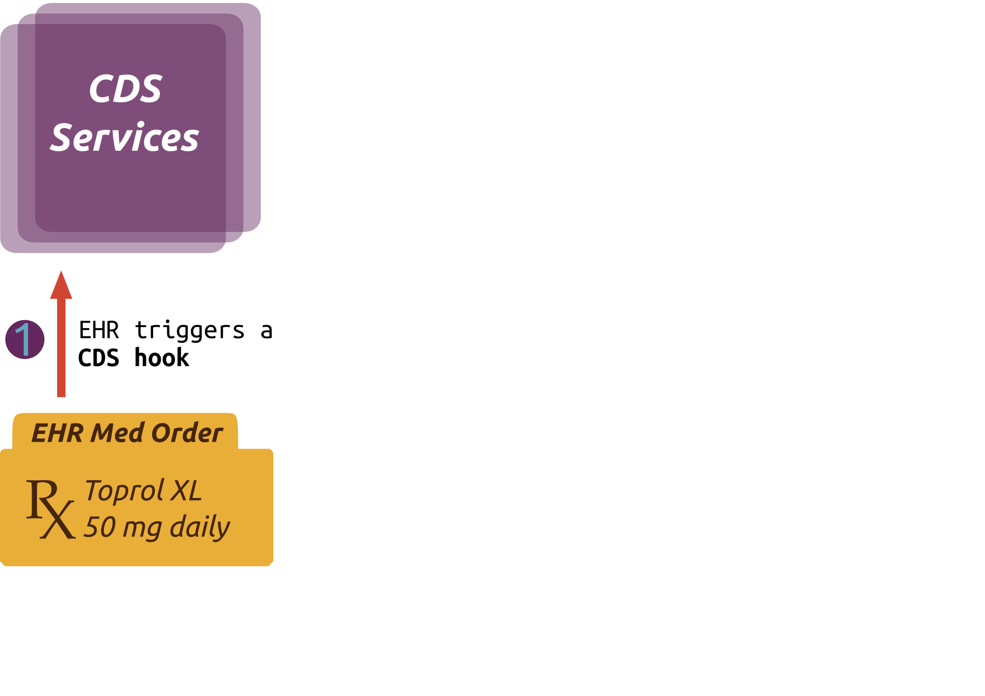

Slide 29
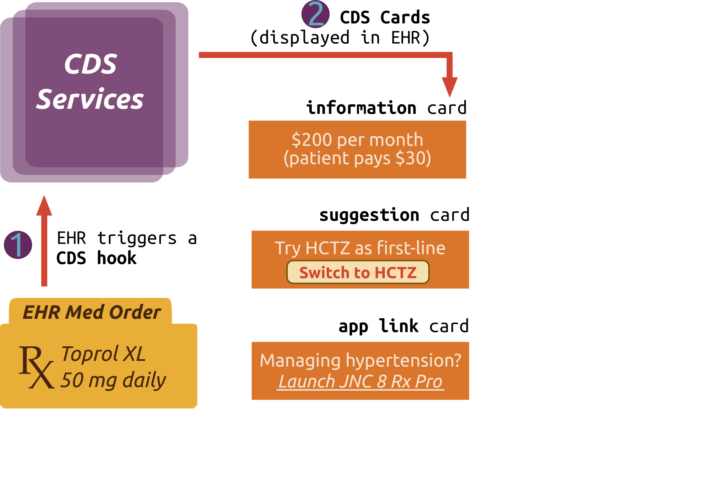

Slide 30
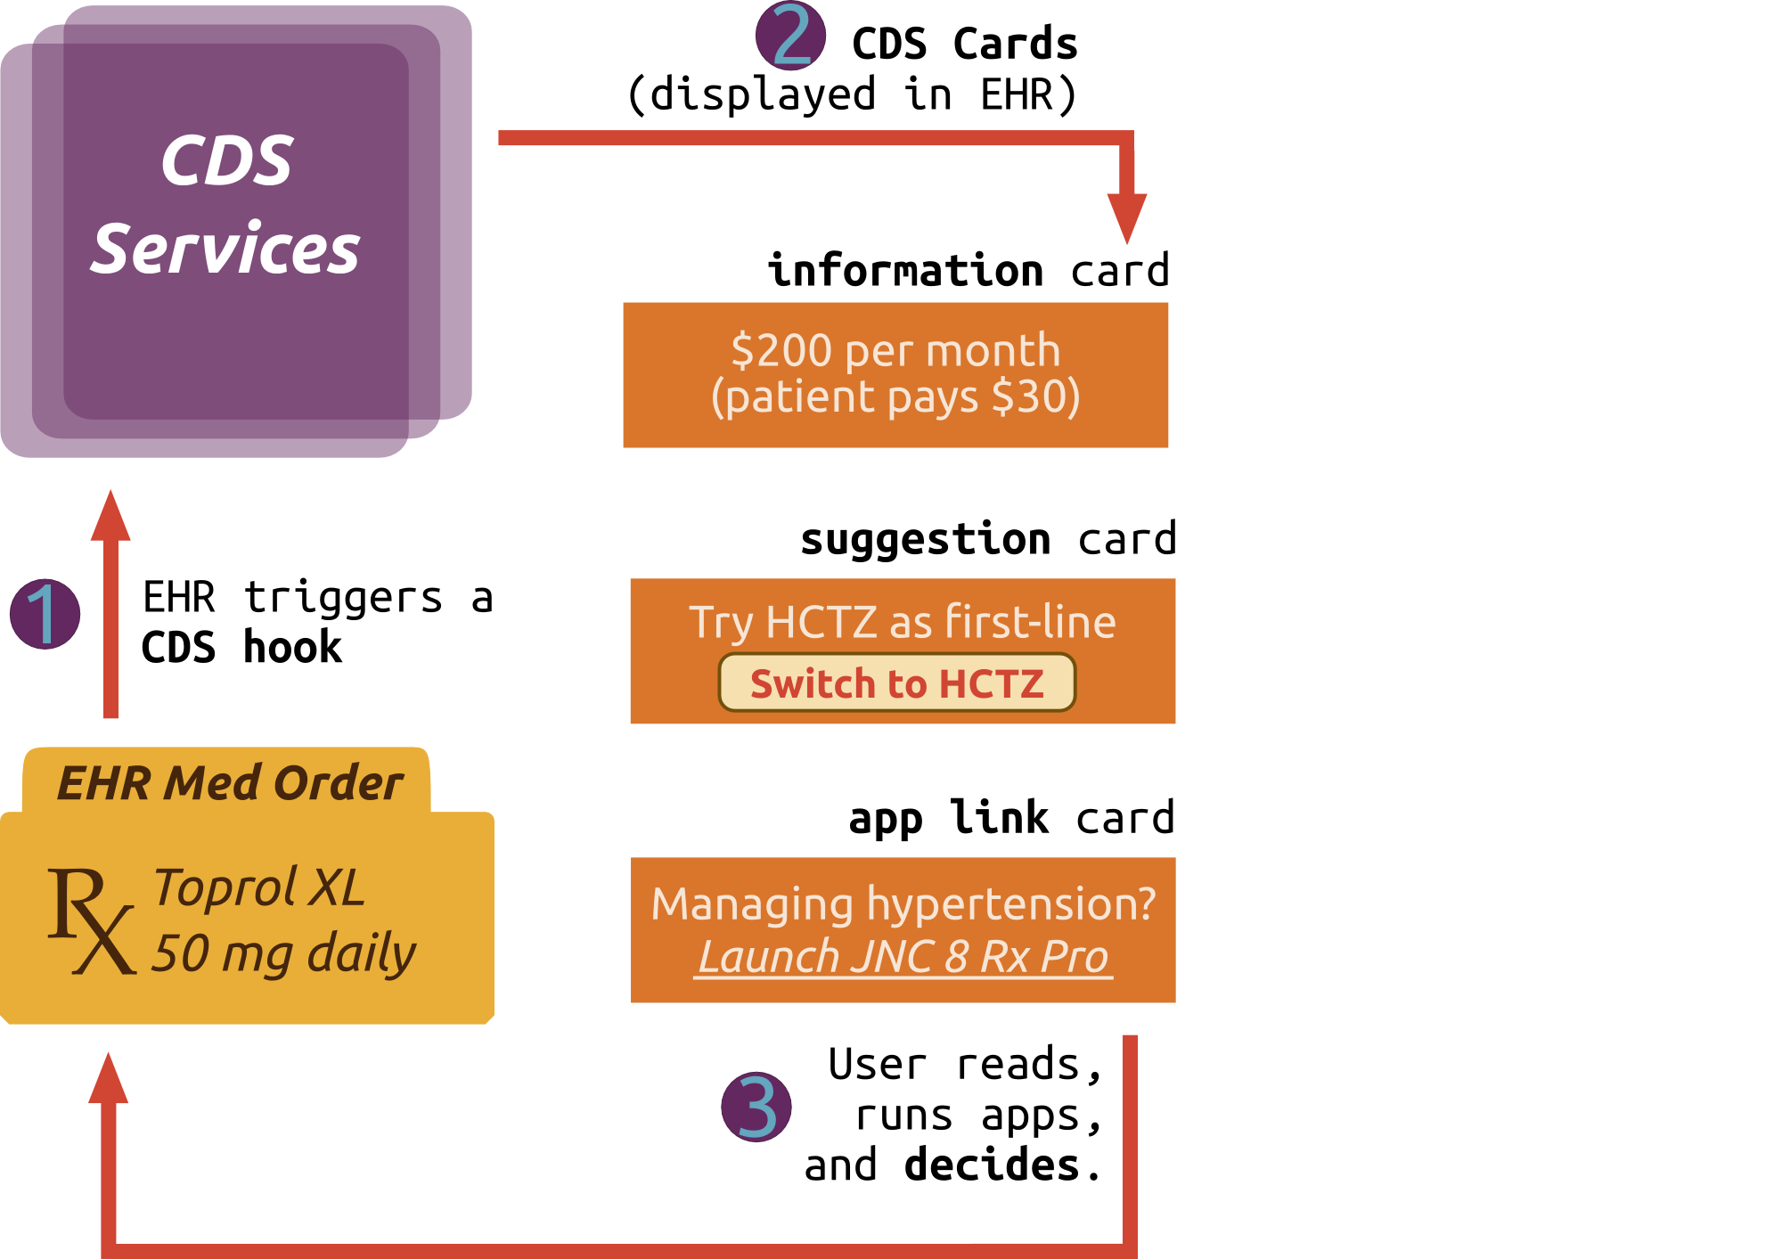

Slide 31
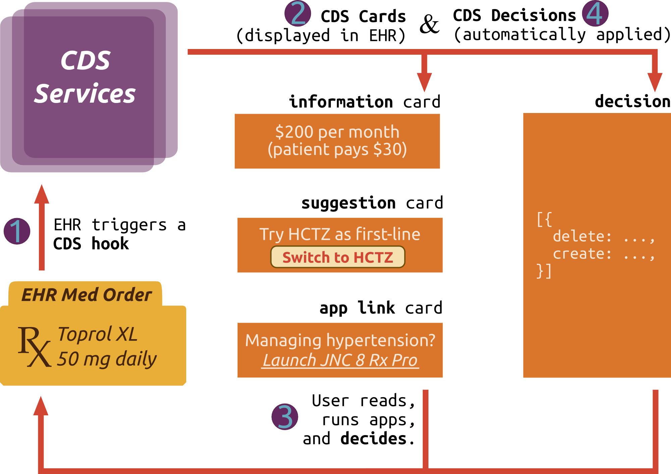

Slide 32
Discovery
GET https://example.com/cds-services
{
"services": [
{
"hook": "patient-view",
"name": "CDS Service Example",
"description": "An example CDS service",
"id": "example-service",
"prefetch": {
"patientToGreet": "Patient/{{Patient.id}}"
}
},
{...}
}
Notes:
Acknowledgement that we likely won’t dynamically interpret this data but it’s important to define this so that we’re standardizing/providing the data for all CDS services.

Slide 33
CDS Service Invocation
{
"services": [
{
"hook": "patient-view",
"name": "CDS Service Example",
"description": "An example CDS service",
"id": "example-service",
"prefetch": {
"patientToGreet": "Patient/{{Patient.id}}"
}
},
{...}
}
POST https://example.com/cds-services/example-service

Slide 34
Separation of Concerns
Concern | Owner
Workflow & hooks (triggers) | EHR
CDS logic | CDS Service Provider
Initial context data | EHR
Additional data | CDS Service Provider (via FHIR or other sources)
CDS presentation | EHR

Slide 35





















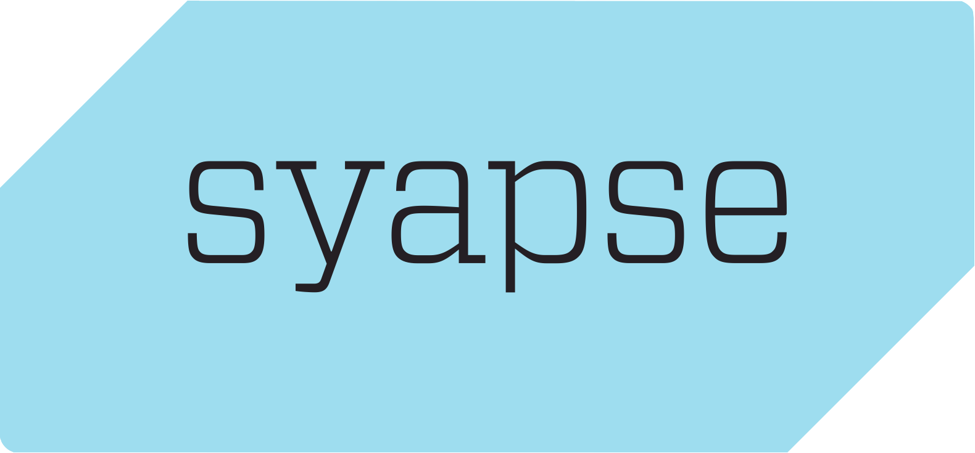


Notes:
Just some of the organizations that have participated in HL7 Connectathons in 2016 to prototype CDS Hooks implements.
Allscripts, Cerner, Epic have implemented CDS Hooks as an EHR. All other companies listed here implemented CDS services.

Slide 36
Live Demo

Slide 37
EHR as Platform – The Emerging Picture
FHIR
Subscription
SMART / FHIR
Services
FHIR Bundles
(Export)
Analytics
DB
EHR Platform
SMART
App
SMART
Component
SMART
Mobile App
SMART Alerts
Via CDS Hooks
EHR WORKFLOW

Slide 38
Areas that need more work…
Performance
Lack of pre-conditions
Prefetching data
SLAs
Security
Additional workflow hooks
Use-case-specific hooks (e.g., ACR radiology order screening?)
Additional types of hooks
Data-flow hooks
Timer-based hooks
Additional result delivery methods
Direct SMART app launch (skip the card display)
Asynchronous delivery of results (e.g., send to “inbox”)
CDS Hooks using rapid iterative development (vs traditional SDOs?)
Harmonization with HL7 Clinical Reasoning project

Slide 39
Q&A
Slides:
bit.ly/cds-hooks-amia2016

Slide 40
Addendum Sample content from CDS vendors developing on CDS Hooks

Slide 41
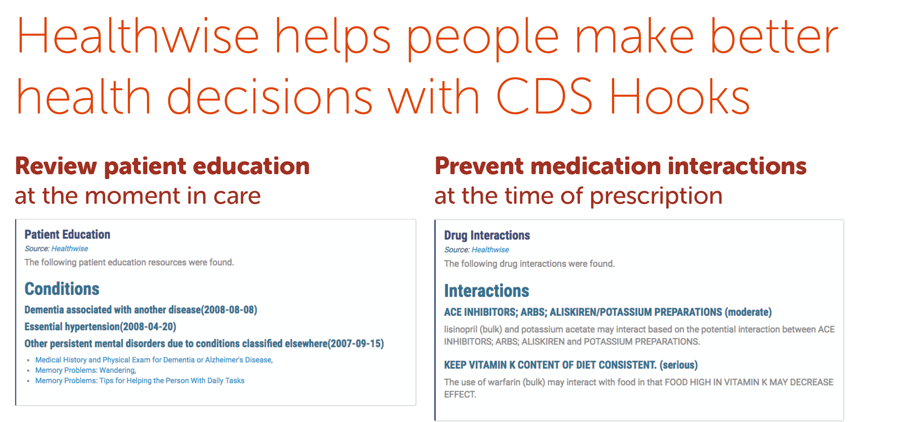
Notes:
CDS Hooks is a specification that describes a pattern designed to invoke decision support tools from a clinician's EHR workflow. CDS Hooks allows EHR systems to integrate with "best of breed" services to provide useful data to the clinician. We believe that Healthwise is the best service to provide information to help people make better health decisions.
Imagine the following use case:
A clinician prescribes a new medication to a patient during a visit. Immediately upon prescribing this medication, data about the new prescription and all the medications a patient is currently prescribed is sent to a service that can provide information about potential interactions between existing medications and the newly prescribed medication. An EHR system that implements the CDS Hooks standard could immediately alert the clinician to the potential interactions.
Or maybe this:
A clinician sees a patient, and when opening the patient record on her tablet, she immediately sees relevant health information for conditions that the patient has been diagnosed with. The info includes tools such as the Healthwise® Decision Points that actively involve the patient in his or her own health care.
Healthwise works hard today to stay on top of the technologies that you need tomorrow. Healthwise is very proud to work with the designers of the CDS Hooks specification and provided several sample services that implementers can reference. These services and infrastructure components are available on the CDS Hooks GitHub page.

Slide 42
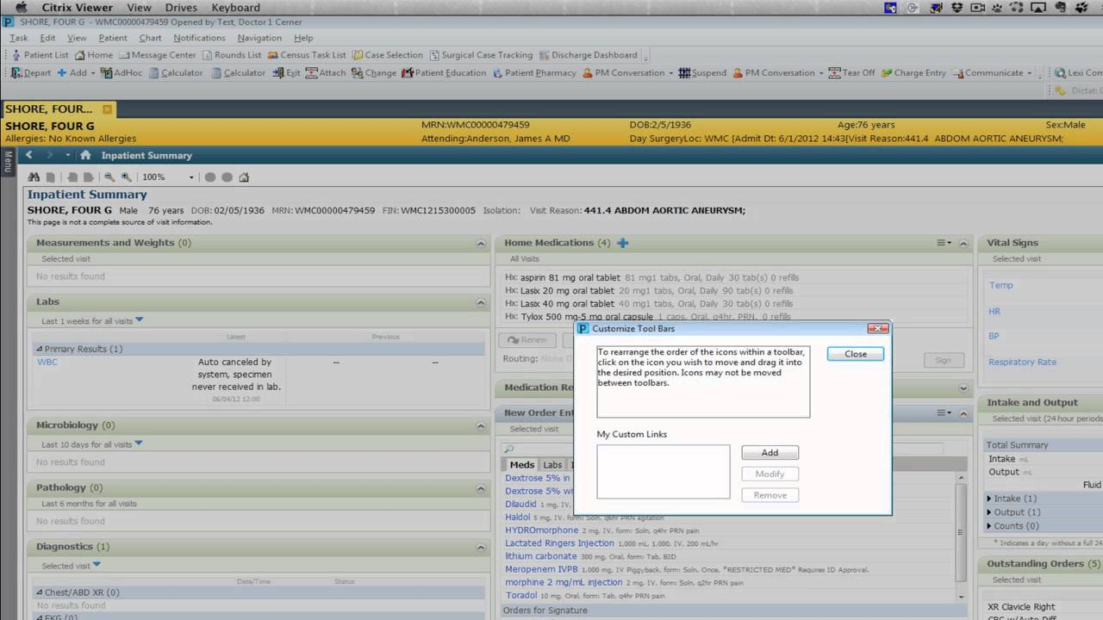


PerfectChoice™
Helping physicians make the perfect antibiotic choices.
IDENTIFY.
DECIDE.
ACT.
PerfectChoice – ID: New Organism Identified
PerfectChoice – ID: New Organism Identified
PerfectChoice Notification: Based on new culture information and facility antibiogram, the following antinfectives have the highest likelihood (% susceptible) of effectively treating the infection.
Source:
Launch Premier TheraDoc for more details.
STEVENSON, LAURA
Age: 4 years CrCl: >100mL/min
Allergies: No Known Allergies SCr: 0.9gm/dL
Previous Admit: 01/18/13
NEW CULTURE INFORMATION
12/22/14 08:45
Specimen ID: 00564783
Status: Prelim
Culture: Blood
Result: E.Coli
STEVENSON, LAURA
Age: 4 years CrCl: >100mL/min
Allergies: No Known Allergies SCr: 0.9gm/dL
Previous Admit: 01/18/13
NEW CULTURE INFORMATION
12/22/14 08:45
Specimen ID: 00564783
Status: Prelim
Culture: Blood
Result: E.Coli
Know the priority patients with new microbiology results with automated surveillance that notifies clinicians in their workflow.
ID SUMMARY
Microbiology
012/20/14 Urine Culture: E.coli
Antibiotic Medications:
01/24/13 – 01/25/13 Amoxicillin-clavulanate 150mg PO q8h
Flags:
Community-acquired infection
Isolation
NHSN Documentation:
None
PerfectChoice OPTIONS
Premier Memorial Hospital – Last 12 mos.
E.Coli - Specimen Source Blood
Antibiotic Medications (% Susceptible)
Ampicillin-Sulbactam (93%)*
Levofloxacin (88%)*
Cefazolin (79%)*
SMX-TMP (76%)*
Gentamicin (73%)*
ID SUMMARY
Microbiology
012/20/14 Urine Culture: E.coli
Antibiotic Medications:
01/24/13 – 01/25/13 Amoxicillin-clavulanate 150mg PO q8h
Flags:
Community-acquired infection
Isolation
NHSN Documentation:
None
PerfectChoice OPTIONS
Premier Memorial Hospital – Last 12 mos.
E.Coli - Specimen Source Blood
Antibiotic Medications (% Susceptible)
Ampicillin-Sulbactam (93%)*
Levofloxacin (88%)*
Cefazolin (79%)*
SMX-TMP (76%)*
Gentamicin (73%)*
Dismiss
Change Orders
Dismiss
Change Orders
View the best antibiotic options based on facility antibiogram in context of the patient’s relevant clinical data to reach the right decision.
Access the EMR to make the appropriate medication order decisions.
A Premier Solution
Notes:
Business Value:
The PerfectChoice SMART on FHIR enabled app solves 3 important problems in a complex healthcare environment. First is notifying clinicians in their EMR workflow when patients’ clinical results needs to be addressed. Secondly, the necessary clinical information can be dispersed across the EMR. This app brings the important clinical data together (patient factors, isolate information, and susceptibility information) so that the clinicians has the right information in context to make the appropriate clinical decision. A unique factor of the app is that it brings facility-specific antibiotic susceptibility information to ensure the physician makes an informed choice, the perfect antibiotic choice for the patient. Third is the ability to move from decision to action. The integrated app allows the physician to access the order entry system of the EMR to activate clinical decision.
Action-Oriented/Required Action
Often the cards returned by the clinical surveillance system to the EHR should be acted on by the clinician immediately. These will likely be implemented with a modal window presented to the clinician for follow up; a clinician who declines to take action would have to consciously dismiss the notification.
Case: Opening patient record prompts action in clinical surveillance system
Actors: Clinician, EHR, clinical surveillance system
Preconditions
A patient record exists in both the EHR and clinical surveillance systems. The clinical surveillance system has new information on the patient relevant to care, such as a updated culture information with the newly identified organism, E.coli.
Flow of Events
1. The clinician opens the patient's chart in the EHR, triggering this workflow.
2. The EHR queries clinical surveillance service with patient context. Clinical surveillance service returns a card with: the new culture information from an existing blood culture with additional contextual information, patient details and an infectious disease summary.
3. The clinician from the card can query clinical surveillance service retrieving E.coli antibiotic susceptibility information stored in the clinical surveillance system and the list of the patient’s active and discontinued anti-infective medication orders over the last 7 days.
4. The clinician evaluates which anti-infective has the highest likelihood (% susceptibility) of effectively treating E.coli infections in the blood and reconciles the patient’s anti-infective recent and/or current anti-infectives orders to ensure the patient is on the most appropriate therapy until susceptibility data is available.
5. The physician may initiate the new medication order through the EHR.
6. The clinician returns to the EHR to continue patient care.
Postconditions
Patient receives a new anti-infective, or the current regimen is continued.

Slide 43
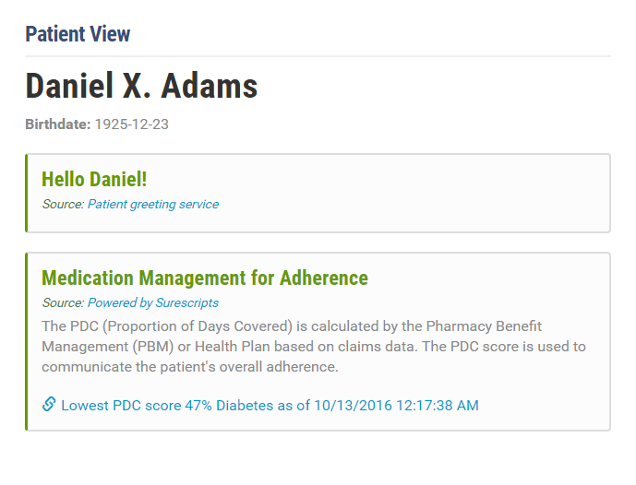
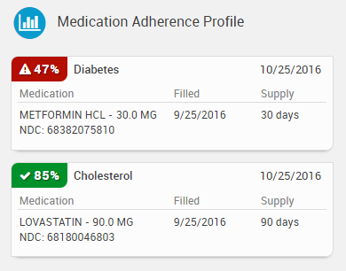
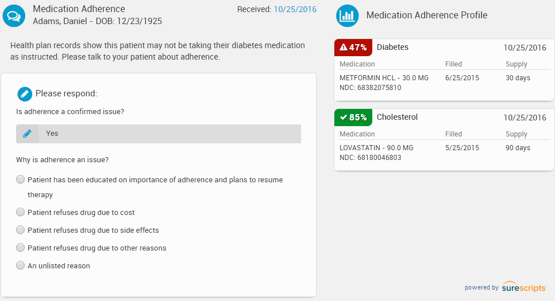
Medication Management for Adherence (CDS Hooks)
Real-time medication adherence insights delivered directly into workflow during patient visits
Bi-directional communication to enable users to provide real-time feedback

Slide 44
Stanson Health’s CDS Hooks service
Real time, workflow integrated, patient specific, evidence based
Reduces low-value and unnecessary care

Slide 45
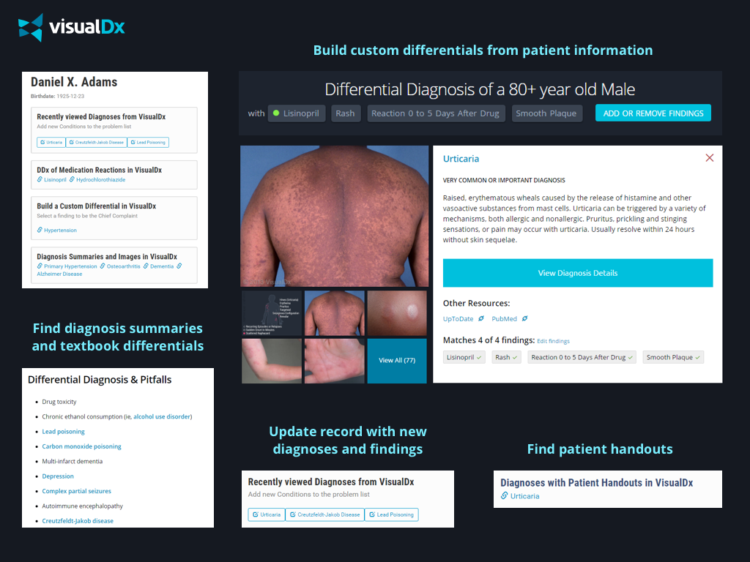

Slide 46
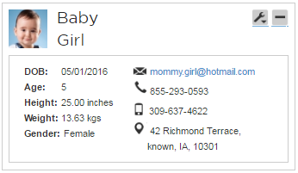
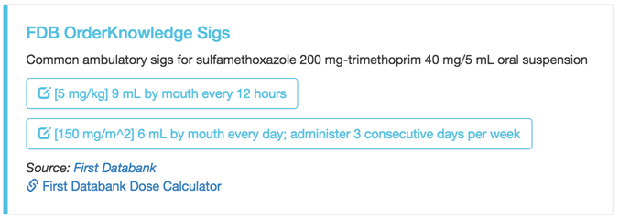
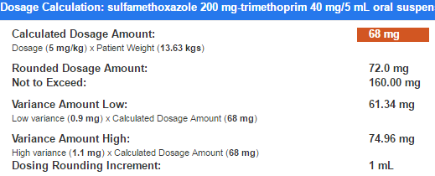
CDS Hooks Dose Calculator
Prevent ADEs with system-calculated, safe, patient-specific doses
Med ordering workflow: pediatric patient, sulfamethoxazole/trimethoprim
Leverages FDB Cloud Connector web services
Calculations happen in real-time using current knowledge base
See common orders for this patient based on their age and the ordered drug
Smart logic knows this order should be dosed as trimethoprim
Select from safe rounded admin amounts
Notes:
FDB has an electronic library in excess of 1,000,000 medication orders (OrderKnowledge®). Order dosages are appropriate & safe based on patient age.
Many orders require the provider to calculate a proper quantity for patient to take in order to fulfill the desired therapeutic dose (e.g. “5 mg/kg”). This is especially prevalent in pediatric settings. The correct calculated quantity varies depending on drug concentration (e.g. 10 mg/5 mL versus 10 mg/20 mL).
Manual calculation leaves room for human error in calculation, and FDB’s web services—which leverage sophisticated dose checking logic and our medication order knowledge base—are not yet widely adopted by leading EHR software.
CDS Hooks accommodates electronic transfer of the patient context & ordered drug (in this case a sulfamethoxazole/trimethoprim formulation) for rapid deployment of a “dose calculator”, which pings FDB’s web services in real time to propose common, safe dosages of the ordered drug for the current patient.

Slide 47
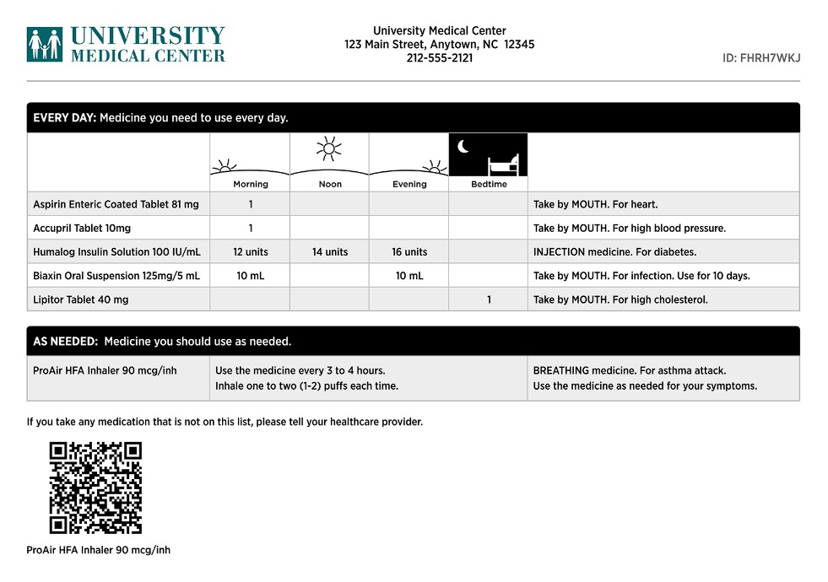
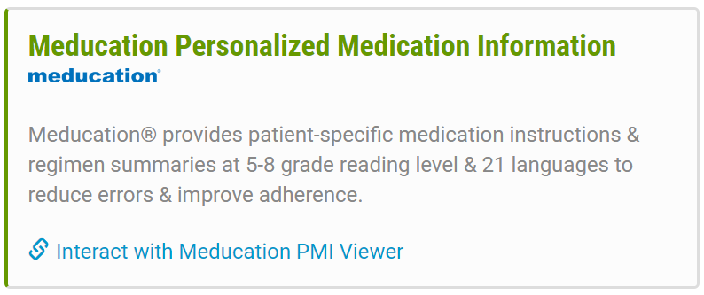
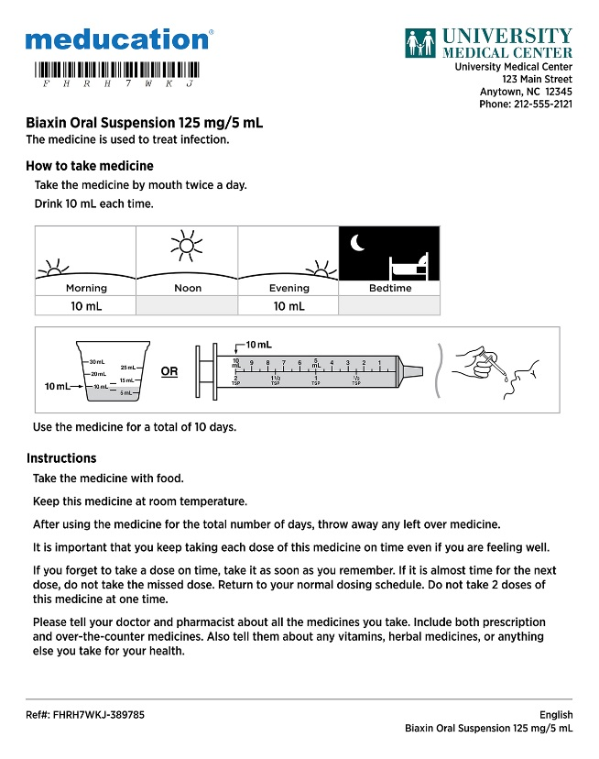
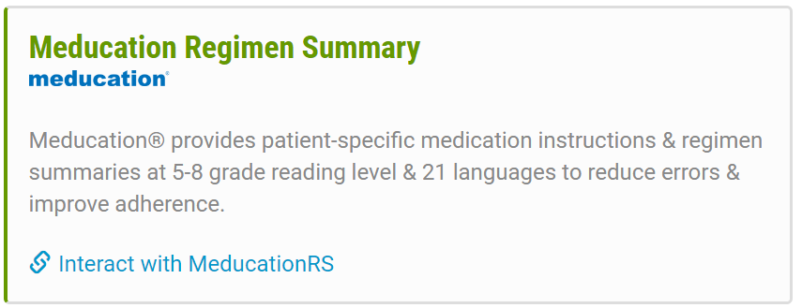
(CDS Hooks)

Slide 48
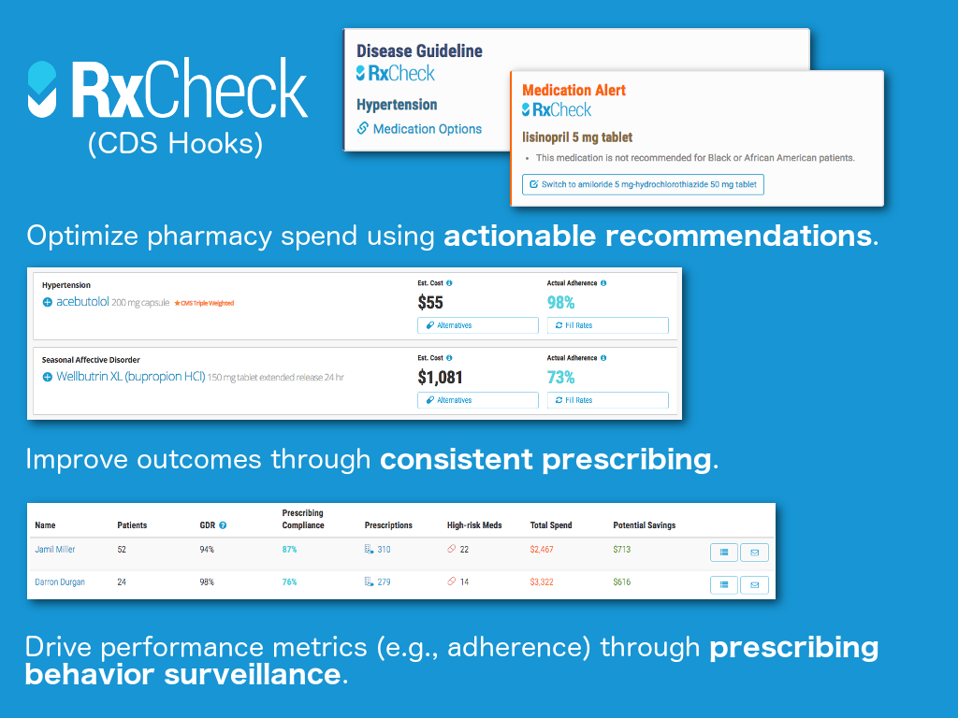

Slide 49
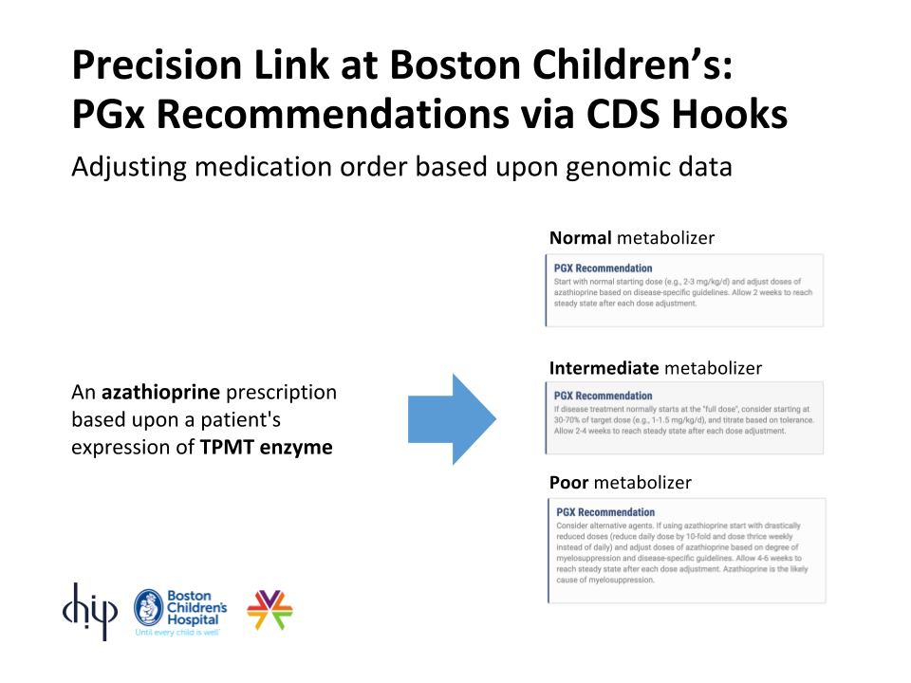
Notes:
Enzyme called TPMT, which breaks down a metabolite of azathioprine (a drug with immuno-suppressant properties, so it's used, for example, in inflammatory bowel disease to limit autoimmune reactions, or after an organ transplant). That metabolite is toxic, so if TPMT is not working at full efficiency, patient experiences toxicity.

Slide 50
References
Specification & documentation
http://cds-hooks.org/
Demo sandbox
http://demo.cds-hooks.org/
Source code
https://github.com/cds-hooks

